Slide 1
Testing
Many people understand many definition of testing:
1.Testing is the process of demonstrating that errors are not present.
2.The purpose of testing is to show that a program performs its intended functions correctly.
3.Testing is the process of establishing confidence that a program does what it is supposed to do.

Slide 2
Software Testing
A more appropriate defination is "Testing is the process of executing a program with the intent of finding errors".
Once source code has been generated, software must be tested to allow errors to be identified and removed before delivery to the customer.
Testing verifies that the system meets the different requirements including,functional, performance, reliability, security, usability and so on. This verification is done to ensure that we are building the system right.
In addition, testing validates that the system being developed is what the user needs. In essence, validation is performed to ensure that we are building the right system.
Software testing contributes to improving the quality of the product.
It is important for software testing to verify and validate that the product meets the stated requirements/specifications.

Slide 3
The Followings Are Some Commonly Used Terms Associated With Testing:
A failure is a manifestation of an error(or defect or bug). But,the mere presence of an error may not necessarily lead to a failure.
A fault is an incorrect intermediate state that may have been entered during program execution,e.g.,a variable value is different from what it should be.A fault may or may ot lead to failure.
A test data is the inputs which have been devised to test the system.
A test case is the triplet(I,S,O),where I is the data input to the system,S is the state of the system at which data is input, and O is the expected output of the system or Inputs to test the system and the predicted outputs from these inputs if the system operates according to its specification.

Slide 4
Software Testing Objectives
Testing is the process of executing a program with the intent of finding errors.
A good test case is one with a high probability of finding an as-yet undiscovered error.
A successful test is one that discovers an as-yet-undiscovered error.

Slide 5
Software Testing Principles
All tests should be traceable to customer requirements.
Tests should be planned long before testing begins.
The Pareto principle(80% of all errors will likely be found in 20% of the code) applies to software testing.
Testing should begin in the small and progress to the large.
Exhaustive testing is not possible.
To be most effective, testing should be conducted by an independent third party.

Slide 6
Software Testability Checklist
Operability:the better it works the more efficiently it can be tested
Observability:what you see is what you test
Controllability:the better software can be controlled the more quickly problems can be isolated and retested intelligently
Simplicity:the less there is to test, the more quickly we can test
Stability:the fewer the changes, the fewer the disruptions to testing
Understandability:the more information known, the smarter the testing

Slide 7
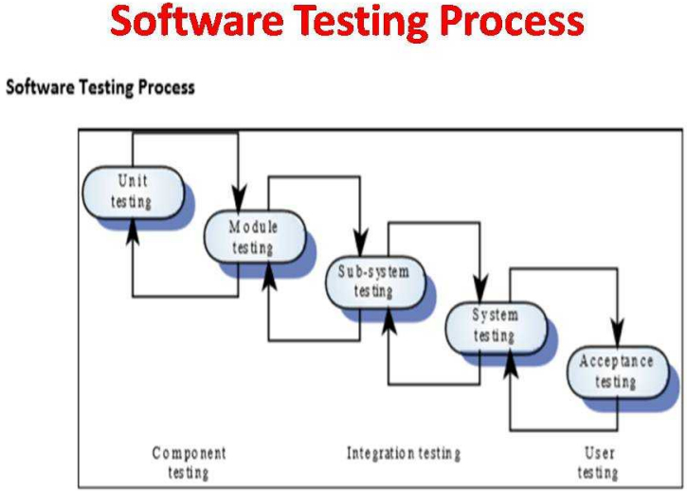

Slide 8
Software Testing Process
Unit testing: Individual components are tested independently, without other system components
Module testing: Related collections of dependent components(class, procedures & functions) are tested, without other system module.
Sub-System Testing: Modules are integrated into sub-systems and tested. The focus here should be on interface testing to detect module interface errors or mismatches.
System testing: Testing of the system as a whole. Validing functional and non-functional requirements & Testing of emergent system properties.
Acceptance Testing: Testing with customer data to check that it is acceptable.

Slide 9
Contd…
Making sure the software works correctly for intended user in his or her normal work environment.
Alpha test: version of the complete software is tested by customer/developer's site.
Beta test: version of the complete software is tested by customer at his or her own site without the developer being present

Slide 10
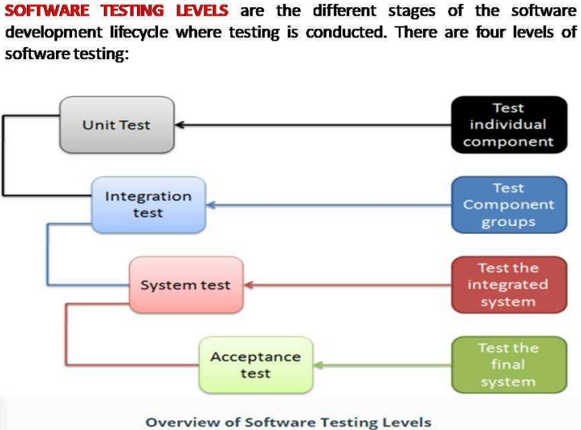

Slide 11
Level Of Testing
1.Unit Testing: A level of the software testing process where individual units of a software are tested. The purpose is to validate that each unit of the software performs as designed.
2.Integration Testing: After unit testing is integration testing. In this stage, all units are integrated together and tested. It is a form of testing in the testing process performed to detect defects in the interactions and the interfaces between the integrated units.
3.System Testing: A level of the software testing process where a complete, integrated system is tested. The purpose of this test is to evaluate the system's compliance with the specified requirements. After integration testing, the fully integrated application is tested to check that whether the system meets its software requirements specification(SRS)..

Slide 12
There are various types of system testing:
Usability Testing: Focuses on the user's ease to operate and use and checks that the user interface is user-friendly
Regression Testing:Type of software testing that checks the performance of existing functionalities when a change is made.
Functional Testing:Type of black box testing that bases its test cases on the specifications of the software component under test.
Recovery Testing:To test that how well a system recovers from crashes,hardware failures,or other catastrophic problems.
Security Testing:To test that the system is secured enough to protect it from unintended users.
Performance Testing:Performance testing is a type of testing that is performed to determine how fast and stable the system performs under a particular workload.
Load Testing:Load testing is a kind of testing which determines the performance of the system under real-life load conditions.It measures the maximum load capacity of the system when multiple users access the system at the same time.

Slide 13
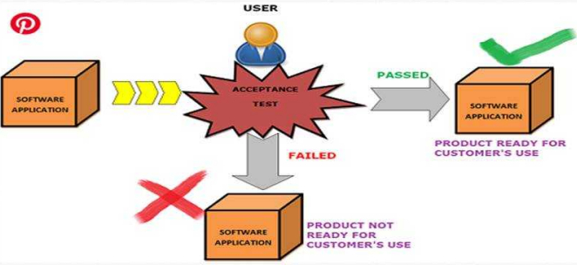
CONTD…
4.Acceptance Testing: A level of the software testing process where a system is tested for acceptability.
The purpose of this test is to evaluate the system's compliance with the business requirements and assess whether it is acceptable for delivery.

Slide 14
Contd…
Broadly, there are two main types of Acceptance Testing
Alpha Testing:
It is an on-site acceptance testing executed at developer's site usually by the group of skilled testers.
This is carried out at the end of the software development process and before the handing over of the software product to clients/users.
The feedback or the collected result from the alpha testing is significantly used to fix bugs or defects, and it is feasible to improve the usability of the product.
Beta Testing:
Also known by the name field testing, Beta Testing is an off-site acceptance testing, carried out at client's site by the stakeholder or the end-users.
This testing involves the evaluation of the software in the real environment by its potential users before its actual release in the market.

Slide 15
Integration Testing Types Or Approaches
There are many different types or approaches to integration testing.
The most popular and frequently used approaches are Big Bang Integration Testing, Top Down Integration Testing, Bottom Up Integration Testing and Incremental integration testing.
The choice of the approach depends on various factors like cost, complexity, criticality of the application etc.
There are many lesser known types of integration testing like distributed services integration, sandwich integration testing, backbone integration, high frequency integration, layer integration etc.
Commonly used integration testing are described below:

Slide 16
Contd…
Big Bang Integration Testing
In Big Bang Integration Testing all components or modules are integrated simultaneously, after which everything is tested as a whole. All the modules from 'Module 1' to 'Module 6' are integrated simultaneously then the testing is carried out
Advantage: Big Bang testing has the advantage that everything is finished before integration testing starts.
Disadvantage: The major disadvantages is that in general it is time consuming and difficult to trace the cause of failures because of this late integration.

Slide 17
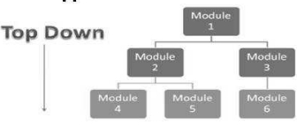
Contd…
Top-Down Integration Testing
Testing takes place from top to bottom, following the control flow
or architectural structure (e.g. starting from the GUI or main menu).
Components or systems are substituted by stubs.
Advantages of Top-Down approach:
The tested product is very consistent because the integration testing is basically performed in an environment that almost similar to that of reality
Disadvantages of Top-Down approach:
Basic functionality is tested at the end of cycle

Slide 18
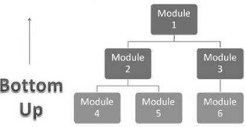
Contd…
Bottom up Integration Testing
Testing takes place from the bottom of the control flow upwards.
Components or systems are substituted by drivers.
Advantage of Bottom-Up approach:
In this approach development and testing can be done together so that the product or application will be efficient and as per the customer specifications.
Disadvantage of Bottom-Up approach:
We can catch the Key interface defects at the end of cycle
It is required to create the test drivers for modules at all levels except the top control

Slide 19
CONTD…
Incremental Integration Testing
Another approach is that all programmers are integrated one by one, and a test is carried out after each step.
The incremental integration testing approach has the advantage that the defects are found early in a smaller assembly when it is relatively easy to defect the cause.
A disadvantages is that it can be time-consuming since stubs and drivers have to be developed and used in the test.
Within incremental integration testing a range of possibilities exist,partly depending on the system architecture.

Slide 20
CONTD…
Sandwich Integration Testing
Sandwich integration testing is a combination of both top down and bottom up approaches.It is also called as hybrid integration testing or mixed integration testing.
In sandwich integration testing,the system is considered to be made up of three layers.
A layer in the middle which will be the target of testing
A layer above the target layer and a layer below the target layer
Testing begins from the outer layer and converges at the middle layer.
Advantage:The benefit of this approach is that top and bottom layers can be tested in parallel
Disadvantage:Extensive testing of the sub-systems is not performed before the integration

Slide 21
CONTD…
Functional Incremental Testing
Integration and testing takes place on the basis of the functions and functionalities,as documented in the functional specification.

Slide 22
Steps-How To Do Integration Testing
Choose the module or component to be tested based on the strategy or approach
Unit testing of the component is to be completed for all the features
Deploy the chosen modules or components together and make initial fixes that are required to get the integration testing running
Perform functional testing and test all the use cases for the components chosen
Perform structural testing and test the components chosen
Record the results of the above testing activities
Repeat the above steps until the complete system is fully tested

Slide 23
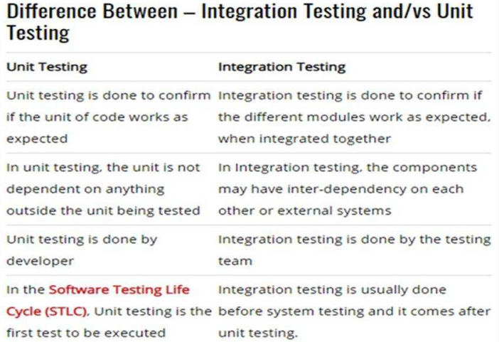

Slide 24
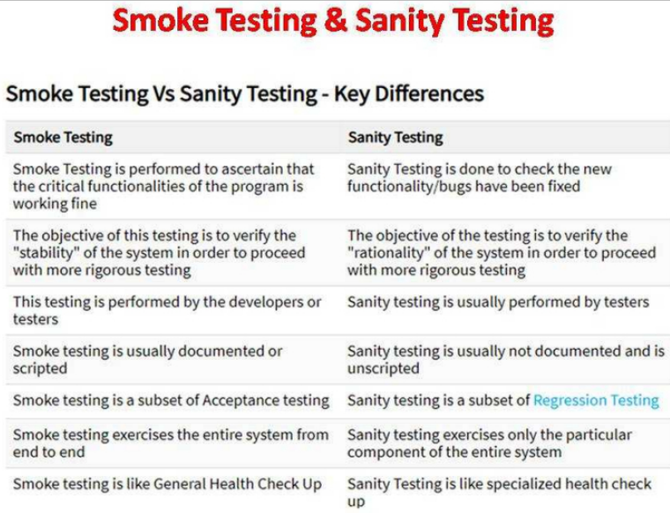

Slide 25
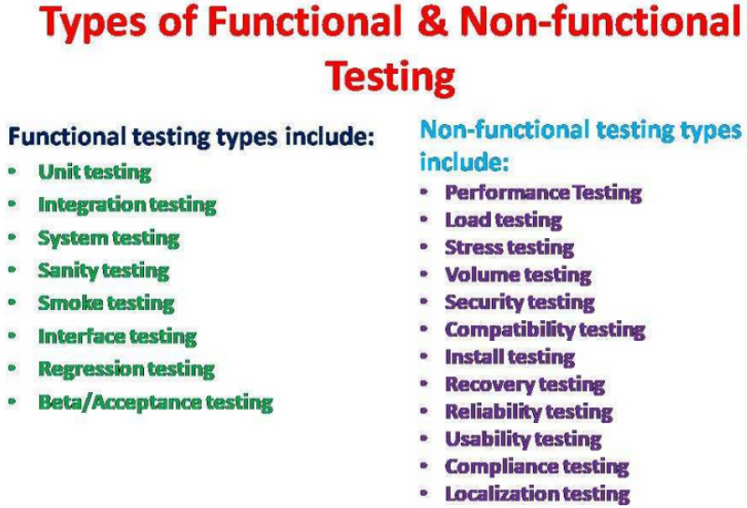

Slide 26
Test Case Design Strategies
1.Black-box or behavioral testing
2.White-box or glass-box testing

Slide 27
Black-box Testing
Also known as Behavioral or Functional testing.
The system is a "Black-box" whoe behavior is determined by studying its input and related the outputs.
It is techniques of knowing the specified function a product is to perform and demonstrating correct operation based solely on its specification without regard for its internal logic.
Focus on the functional requirements of the software i.e,information domain not the implementation part of the software.
Different categories of errors include incorrect or missing functions, interface error, errors in data structures or external database access, behavior or performance errors, and initiation and termination errors.
It is performed during later stages of testing process, like in the acceptance testing or beta testing.

Slide 28
White-box Testing
Also known as Structural or Glass-box testing.
Knowing the internal workings of a product, tests are performed to check the workings of all independent logic paths.
It uses the control structure of the procedural design to derive test cases that:
Guarantee that all independent paths within a module have been exercised at least once.
Exercise all logical decisions on their true and false sides.
Execute all loops at their boundaries and within their operational bounds
Exercise internal data structures to ensure their validity.

Slide 29
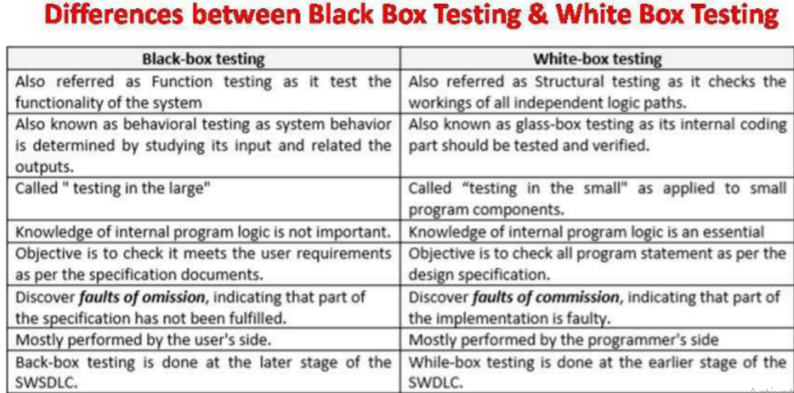

Slide 30
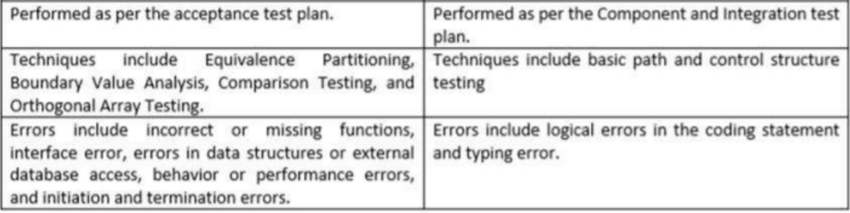

Slide 31
Differences Between Validation And Verification
Software testing is one type of a brooder domain that is known as verification and validation (V&V).
Verification and validation is intended o show that a system conforms to its specification and meets the requirements of the system customer. It involves checking and review processes and system testing.

Slide 32
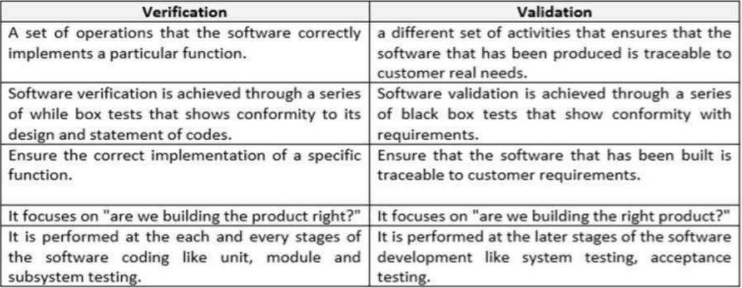

Slide 33
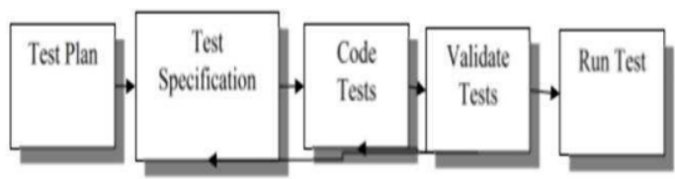
Software Testing Plan
Preparation and planning for the test phase should begin early in the development cycle and be a constant concern throughout the development process.
Fig: Test development cycle

Slide 34
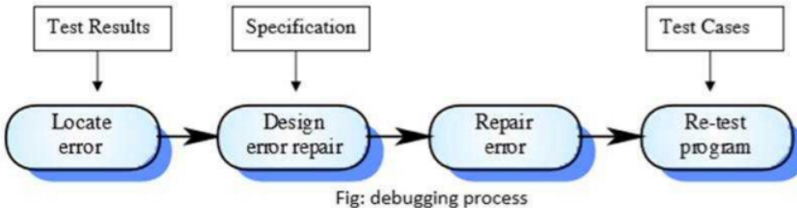
Debugging
Debugging (removal of a defect) occurs as a consequence of successful testing.
Testing establishes the existence of defects where as debugging is concerned with locating and correcting these defect.
Debugging Process
Defects in the code must be located and the program modified to meet its requirements. Testing must then be repeated to ensure that the change has been made correctly. Thus debugging process is a part of both software development and software testing.

Slide 35
Software Quality Assurance
The aim of SQA is to help organizations develop high quality software.
Conformance to software requirements is the foundation from which software quality is measured.
Specified standards are used to define the development criteria that are used to quide the manner in which software is developed.
Software must conform to implicit requirements as well as its explicit requirements.

Slide 36
Contd…
Software Quality is defined as "Conformance to explicitly stated functional and performance requirements, explicitly documented standards and implicit characteristics that are expected of all professionally developed software".
Above defination serves three important points:
s/w requirements form a foundation for quality being measured. Lack of conformance to requirements is lack of quality.
If specified standards, that define a set of development criteria is not followed;lack of quality will almost surely result.
If s/w conform to its explicit requirements but fails to meet implicit requirements,s/w quality is suspect.

Slide 37
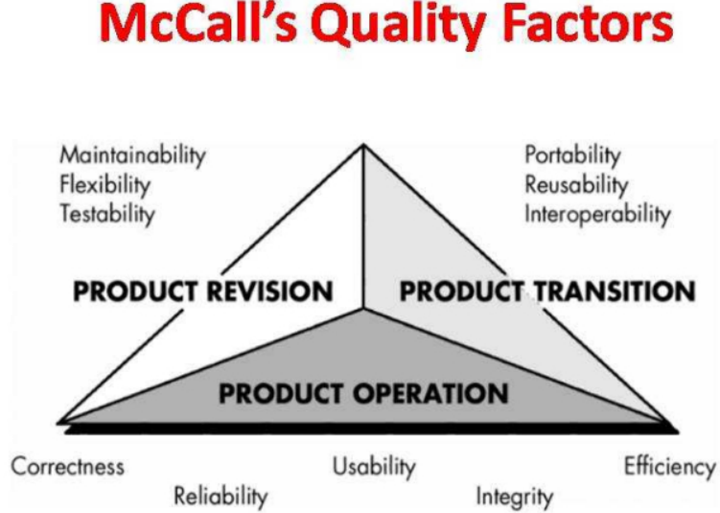

Slide 38
Software Quality Management
Concerned with ensuring that the required level of quality is achieved in a software product.
Involves defining appropriate quality standards and procedures and ensuring that these are followed.
Should aim to develop a 'quality culture' where quality is seen as everyone's responsibility.
Quality Management Activities:
a)Quality Assurance
b)Quality Planning
c)Quality Control

Slide 39
Quality Assurance
Establishes a framework of organizational procedures and standards for high quality s/w.
Consists of auditing and reporting procedures used to provide management with data needed to make proactive decisions.
If data provided through QA identifies problems, management is responsible to address the problem and apply the necessary resources to resolve quality issues.
Quality Planning
Selection of appropriate procedures and standards from this framework and adaptation of these for specific s/w projects and modify these as required.
A quality plan sets out the desired product qualities and how these are assessed and the most significant quality attributes.

Slide 40
Quality Control
It ensures that the project quality procedures and standards are followed by the s/w development team.
QC involves the series of inspection, reviews and test used throughout the s/w process to ensure conformance of a work product to its specifications.

Slide 41
Costs Of Quality
a)Prevention cost
b)Appraisal cost
c)Failure cost

Slide 42
ISO 9000 Quality Standards
ISO 9000 describes quality assurance elements in generic terms that can be applied to any business.
It treats an enterprise as a network of interconnected processes.
To be ISO-compliant,processes should hold to the standards described.
Elements include organizational structure, procedures, processes and resources.
Ensures quality planning, quality control, quality assurance and quality improvement.
ISO 9001 standardizes the SQA activities.
ISO 9000 is a generic standard-means that the standard can be applied to any organization,large or small,whatever its product in any sector of activity
ISO is an auditable system-organization may be certified to a market standard by outside agency(Weigers,2001)

Slide 43
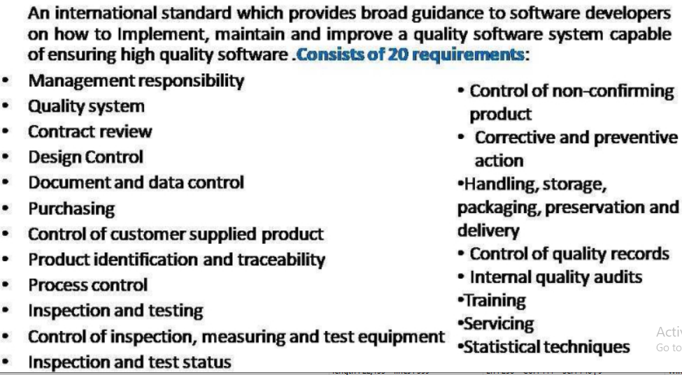

Slide 44
CMM
CMM: Compability Maturity Model
Developed by the Software Engineering Institute of the Carnegie Mellon University
Framework that describes the key elements of an effective software process.
Describes an evolutionary improvement path for software organizations from an ad hoc, immature process to a mature, disciplined one.
Provides guidance on how to gain control of processes for developing and maintaining software and how to evolve toward a culture of software engineering and management excellence.

Slide 45
What are the CMM Levels
(The five levels of software process maturity)
Maturity level indicates level of process capability:
Initial
Repeatable
Defined
Managed
Optimizing

Slide 46
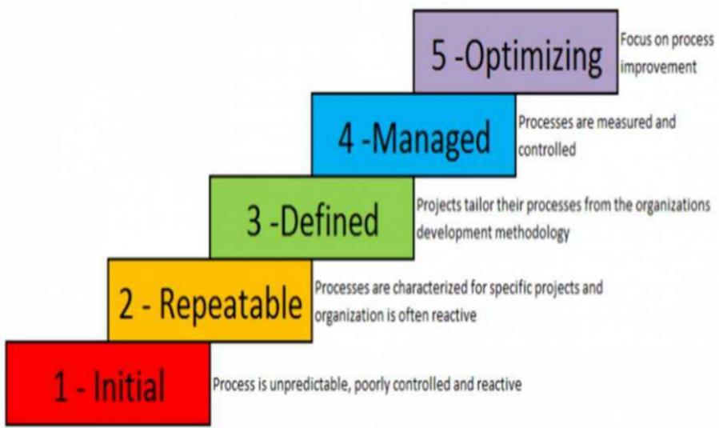

Slide 47
Level 1:Initial
Initial : The software process is characterized as ad hoc,and occasionally even chaotic. Few processes are defined, and success depends on individual effort.
-Products developed are often over budget and schedule
-Wide variations in cost,schedule,functionality and quality targets
-Capability is a characteristic of the individuals, not of the organization
-80% of software organizations worldwide

Slide 48
Level 2:Repeatable
.Basic process management processes are established to track cost, schedule, and functionality. The necessary process discipline is in place to repeat earlier successes on projects with similar applications.
Realistic project commitments based on results observed on previous projects
Software project standards are defined and faithfully followed
Processes may differ between projects
Process is disciplined
Earlier successes can be repeated
15% of software organizations worldwide

Slide 49
Level 3:Defined
The software process for both management and engineering activities is documented, standardized, and integrated into a standard software process for the organization. All projects use an approved software process model for developing an maintaining software.
5% of software organizations worldwide

Slide 50
Level 4:Managed
Quality and performance is measured using metrics and can be predicted
Quality and productivity quantitative goals are established
Exceptional cases are identified and addressed
Challenge of new domains can be managed
Process is measured and operates within limits
1% of software organizations worldwide

Slide 51
Level 5:Optimizing
Organization focuses on continuous process improvement
Goal is to address and prevent problems by analyzing their cause in the process
Process improvement is budgeted, planned, and part of the organization's process
Identify and quickly transfer best practices
Only a handful of organizations worldwide

Slide 52
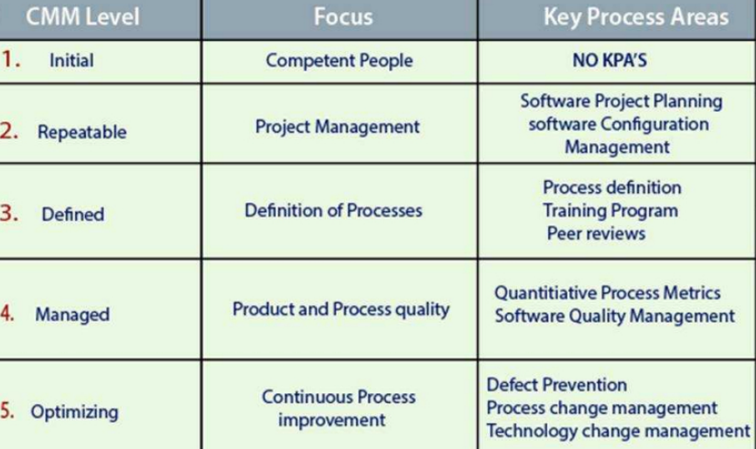

Slide 53
Software Reviews
Purpose is to find defects (errors) before they are passed on to another software engineering activity or released to the customer.
Software engineers (and others) conduct formal technical reviews (FTR) for software engineers.
Using formal technical reviews (walkthroughs or inspections) is an effective means for improving software quality.

Slide 54
Formal Technical Reviews
Involves 3 to 5 people (including reviewers)
Advance preparation (no more than 2 hours per person) required
Duration of review meeting should be less than 2 hours
Focus of review is on a discrete work product
Review leader organizes the review meeting at the producer's request
Reviewers ask questions that enable the producer to discover his or her own error (the product is under review not the producer)
Producer of the work product walks the reviewers through the product
Recorder writes down any significant issues raised during the review
Reviewers decide to accept or reject the work product and whether to require additional reviews of product or not

Slide 55
Unit 6(Software testing and QA): Assignment
Define Software testing. Why do you need Software testing?
Explain about the software testing process
Explain about the level of testing.
Differentiate between verification and validation. Explain why software inspection is an effective technique for discovering errors in software?
What do you mean by software quality management? Explain software quality management activities in brief.

Slide 56
Unit 6(Software testing and QA): Assignment 2
What is Acceptance Testing? What are the different types of acceptance testing
Define Integration Testing Types. Explain different types of integration testing types
What are the differences between smoke testing and sanity testing?
What are the differences between integration and unit testing?
What are ISO quality standards? Discuss ISO9000 and ISO9001. Explain Black box testing and white box testing techniques.
Define quality assurance. Under what circumstances would you recommend the use of staged representation of the CMM?

